Slide 1
PATH EADUCATION (pvt). Ltd

Slide 2
Table of Content
What is Computer
Computer System
Computer Subsystem
How the Subsystem is Connected and Organized
Purpose of the CPU
CPU Dependency and Performance

Slide 3
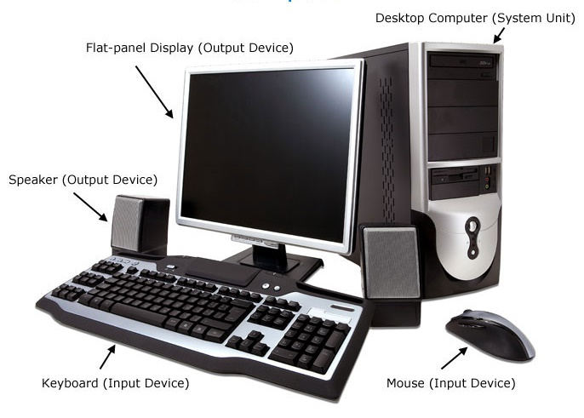
WHAT IS COMPUTER
A computer is a programmable device that can store, retrieve, and process data.
Today's computers are electronic devices that accept data (input), a process that data, produce output, and store(storage) the results.

Slide 4
COMPUTER SYSTEM
Definition:-
This is a collection of entities(hardware, software, Firmware, and live ware) that are designed to receive, process, manage and present information in a meaningful format.
Component of computer system:-
Hard ware
Soft Ware
Live Ware
Firm Ware

Slide 5
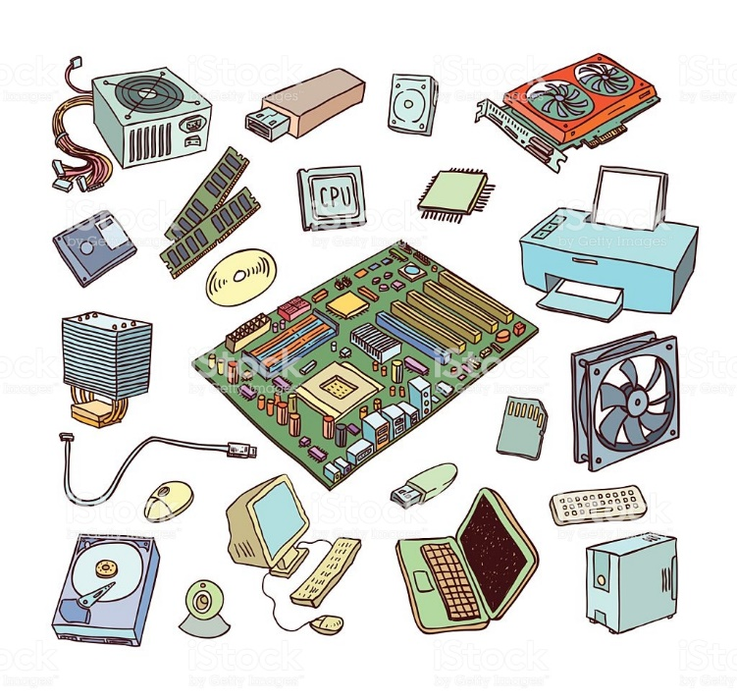
Hard Ware
Hardware is best described as any physical component of a computer system
Without any hardware, your computer would not exist, and software could not be used.
E.g.:-
Motherboard
CPU
Printer
Power supply

Slide 6
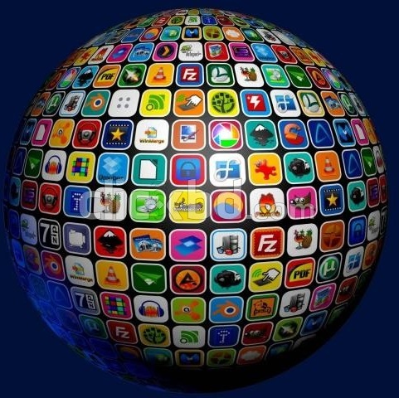
Soft Ware
software is a collection of instructions that enable the user to interact with a computer, its hardware, or perform tasks. Without software, most computers would be useless.
There are two types of Software
Application Software
System Software
E.g.:-
Office package
Player
Photoshop

Slide 7

Live Ware
Live ware is a term to describe the human system, opposed to hardware or software in a computer.

Slide 8
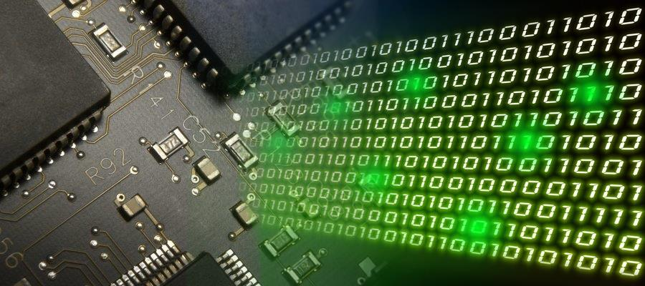
Firm Ware
Firmware is data that is stored on a computer or other hardware devices ROM (read-only memory) that provides instruction on how that device should operate.
Unlike normal software, firmware cannot be changed or deleted by an end-user without the aid of special programs and remains on that device whether or not it's on or off.
Cannot see this with eyes

Slide 9
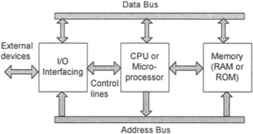
COMPUTER SUBSYSTEM
Computer subsystems typically refer to big components of machine Hardware.
We can think of computer hardware as consisting of three separate subsystems as shown in
CPU
Memory
Input / Output Device

Slide 10
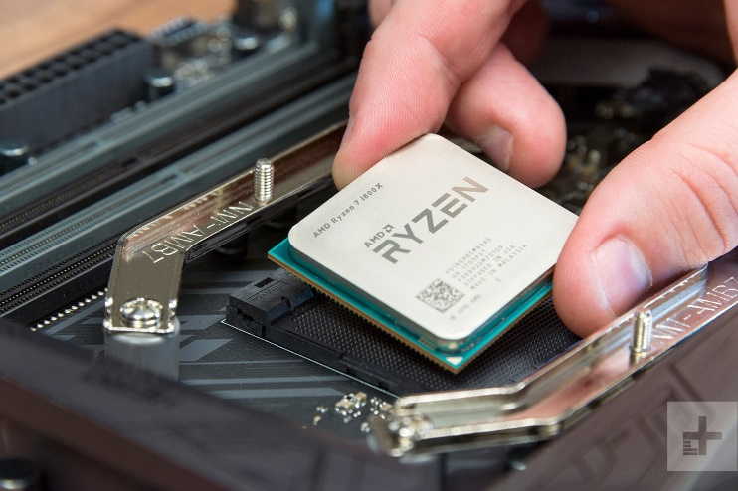
CPU
Central Processing Unit – CPU
Central processing unit the most important component of any computing device.
CPU process can be broken down into three key stages: Fetch, decode, and execute.
CPU does not do everything, but it still has to specialized hardware they need to do their job
Gigahertz(GHz) used to measure the speed in CPU
There are many types of CPU
E.g.:-
Celeron
Intel
Pentium
AMD

Slide 11
Memory
Computer memory is a device storing information.
E.g.:-
RAM
ROM
There are two types of memory
Volatile Memory:-
A memory that loses its contents when the computer or hardware device loses power.
RAM is example of volatile memory
Non-Volatile Memory:-
Nonvolatile memory that keeps its contents even if the power is lost in .
ROM is example of nonvolatile memory

Slide 12
Storage
Memory is not disk storage.
It is very common for new computer users to be confused by what parts of the computer are a memory.
There are two type of storage in computer.
Primary Storage :- RAM, ROM,
Secondary Storage :- Flash drive, DVD, Hard disk
Storage measurement
4nibble - 1bit
8bit - 1byte
1024byte - 1megabyte(mb)
1024megabyte - 1gigabyte(gb)
1gigabyte - 1terabyte(tb)
1terabyte - 1petabyte(pb)

Slide 13
ROM
Read Only Memory – ROM
This is a type of storage medium that permanently stores data on personal computers (PCs) and other electronic devices
The Types of ROM
Programmable Read-Only Memory (PROM)
Electrically Programmable Read-Only Memory (EPROM)
Electrically Erasable Programmable Read-Only Memory (EEPROM; also called Flash ROM)
Electrically Alterable Read-Only Memory (EAROM)

Slide 14
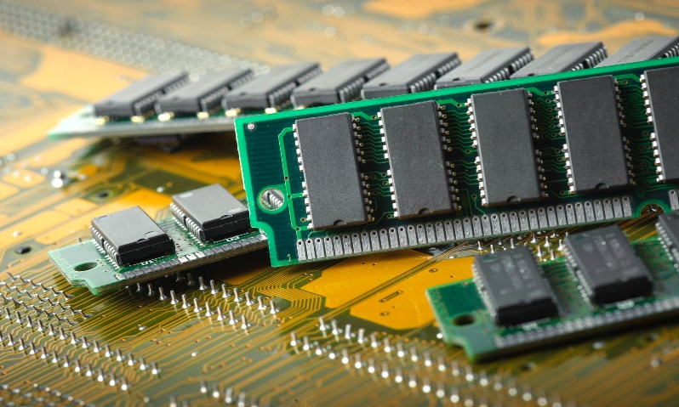
RAM
Random Access Memory – RAM
This is a type of storage medium that temporary stores data on personal computers.
Diagram of RAM
RAM
DRAM
SDRAM
RDRAM
SRAM
DDRRAM
DDR1
DDR2
DDR3
DDR4

Slide 15
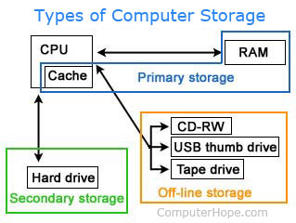
Secondary Storage
Alternatively referred to as external memory, secondary memory, and auxiliary storage, a secondary storage device is a non-volatile device that holds data until it is deleted or overwritten.
Without primary storage, if you were working on a document and the power turned off, everything would be lost because primary storage is temporary. However, a computer with secondary storage that saved the file before the power turned off would be able to recover the last saved version of the file.
E.g.:-
Hard drive
Flash drive
SD card – Secure Digital Card
DVD - Digital Video Disc

Slide 16
Hard drive
The hard drive is non volatile memory.
Its high storage volume in – terabyte(tb)
The hard disk connect to the mother board using an IDE, ATA, SCSI or SATA cable.
There are two type hard drive
HDD – Hard Disk Drive
SSD - Solid State Drive

Slide 17
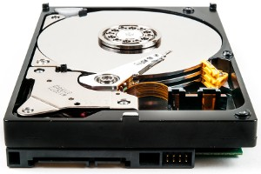
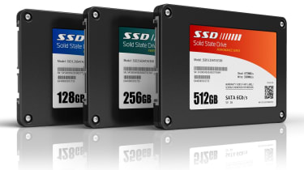
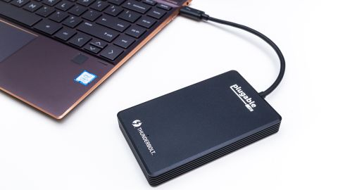
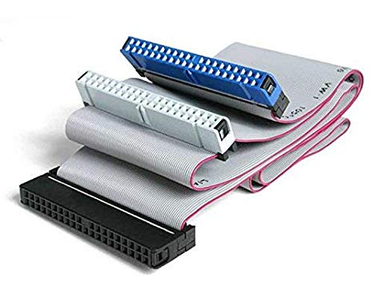
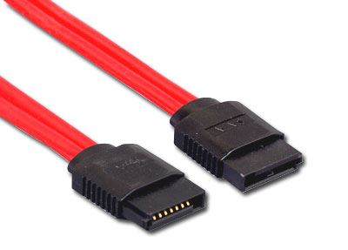
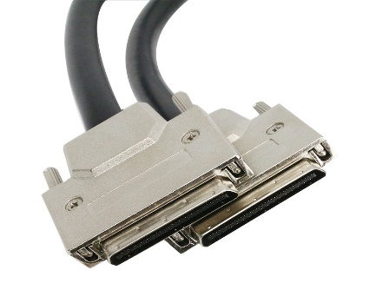
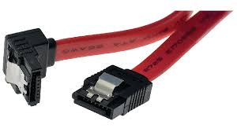
HDD
SSD
External hard drive
IDE Cable
ATA Cable
SCSI Cable
SATA Cable

Slide 18
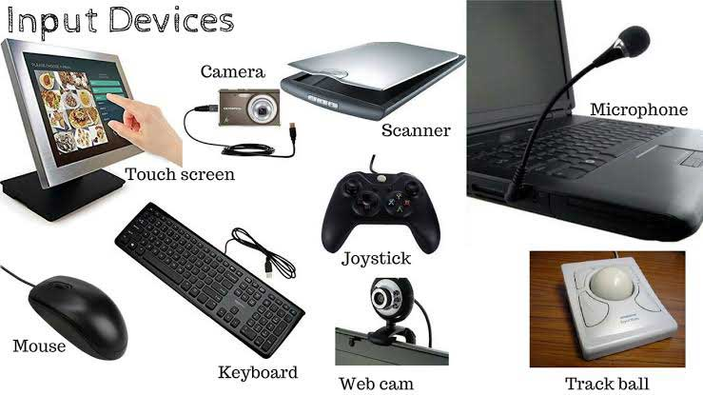
INPUT DEVICE
An input device is useful for communicating and controlling information.
The most commonly used or primary input devices on a computer are the keyboard and mouse.
That can also be used to input data into the computer
There are many types of the input device
Audio conversion device
Barcode reader
Biometrics
Mouse
Light gun
MICR
Scanner

Slide 19
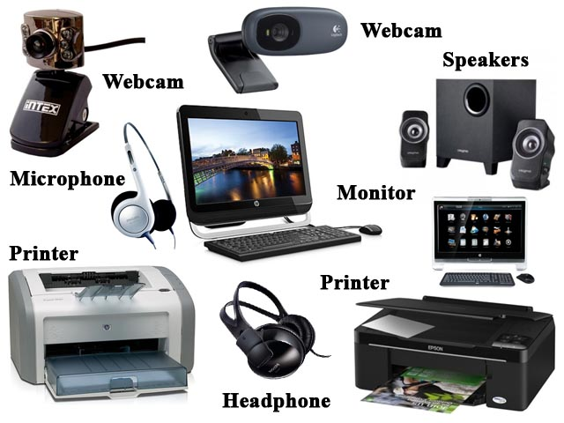
OUTPUT DEVICE
An output device is any peripheral that receives data from a computer
The most commonly used or primary input devices on a computer are the monitor and speaker.
That can also be used to output information into the computer
There are many types of the output device
Monitor
Speaker
3D Printer
Projector
Head phones
COM – Computer Output Microfilm
GPS

Slide 20
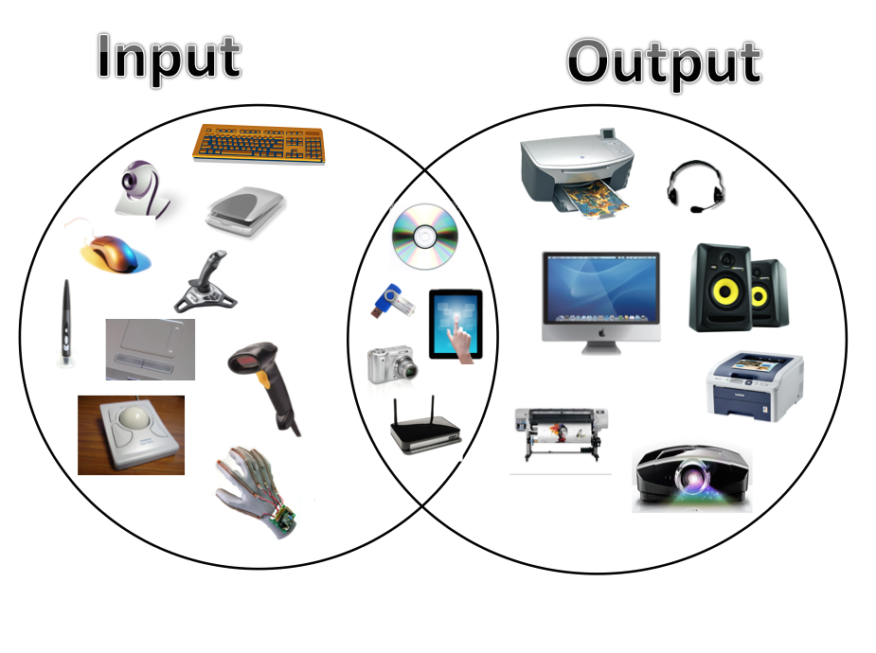
INPUT AND OUTPUT DEVICE

Slide 21
HOW THE SUBSYSTEM IS CONNECTED AND ORGANIZED
These subsystems need to be directed just as much as the overall system and to be granted relevant cultures and objectives that align with those of the company as a whole.
Each subsystem will tend to develop its own rules and culture, which contribute to its functioning, but they must also contribute to the overall success of the organization.

Slide 22
PURPOSE OF THE CPU
The CPU is the central processing unit of the computer.
A computer's CPU handles all instructions it receives from hardware and software running on the computer.

Slide 23
THE STRUCTURE OF CPU
The two typical components of a CPU.
ALU – Algorithm Logical Unit
which performs arithmetic and logical operations.
CU - Control Unit
which extracts instructions from memory and decodes and executes.

Slide 24
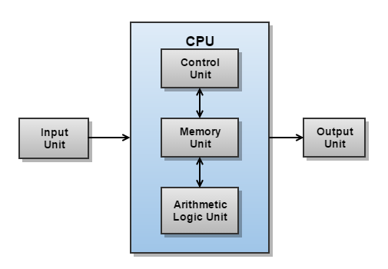
FUNCTION OF CPU

Slide 25
CPU DEPENDENCY AND PERFORMANCES
This can vary widely by CPU, and it primarily dependent on six things:
Clock Rate of the CPU - that is, how many internal operations-per-second (nowadays measured in Gigahertz) does the CPU perform
Number of available calculation units - generally speaking, those CPUs with more execution units can perform more work per unit time than those with fewer execution units. Typically, these days we measure this in "cores", though this isn't technically correct. This speed is dependent on the specific workload, so you really need to know what the typical workload of the CPU is, before this metric can be applied.
Size of on-die caches - larger L1, L2, and L3 caches speed up memory access, which leads to faster performance. There generally is a law of diminishing returns in cache size, so bigger will not always give you better performance. In addition, certain workloads are too big to fit into any reasonable cache size, so the performance of the CPU isn't affected by cache size for those workloads.

Slide 26
Design of the CPU bus protocol - certain CPU bus protocols are more efficient than others, and improvements in bus protocols lead to faster communications between CPUs (in a multi-CPU system) and/or Memory and/or I/O subsystems.
Size and speed of the external buses - the "width" of the buses (as well as the clock rate of such buses) attached to a CPU heavily influences the ability of the attached subsystems to get data to the CPU. Data starvation is a primary cause of perceived slowness in CPUs.
Design of the CPU sub architecture - engineers are continually refining and improving the internal design of the CPU itself. Later generations of a CPU are almost always faster, due to improved layout or new innovations which make calculations faster (even given no change in any of the other above factors).

